Slide 1
ECO Frequency Information System (EFIS) Overview
CEPT Workshop on European Spectrum Management and Numbering
4th June 2014

Slide 2
What is EFIS – A first overview
Frequency information system that should show the actual spectrum use in CEPT countries – Mandated by EC (EC Decision for EFIS & Spectrum Inventory (Radio Spectrum Policy Programme)
Created in 2001 and administered by ECO
National information uploaded by the CEPT administrations
European Common Allocation Table and ITU Region 1 Allocations uploaded by ECO

Slide 3
Overview & general info
Tables/accounts available in EFIS:
44 countries, including all 28 EU Member States (Administrations upload their information)
ITU-R Region 1 Table
European Common Allocation (ECA) Table
TCAM table (R&TTE equipment subclasses 1 and 2 information, searchable by frequencies and/or applications)
Data types in EFIS: Allocations - this is basically all the National Tables of Frequency Allocations, ECA and ITU Region 1
Applications – ECA and national frequency utilisation(applications) planning – more details than allocations
Radio interfaces (national radio interfaces and radio interface templates for ECC Decisions)
Documents (regulatory - Decisions /Recommendations) and non-regulatory (Reports, e.g. CEPT, ECC, questionnaire summaries etc.)
Right of use info
All data types are searchable and types 1 – 3 are comparable
for national as well as ECA and ITU tables

Slide 4
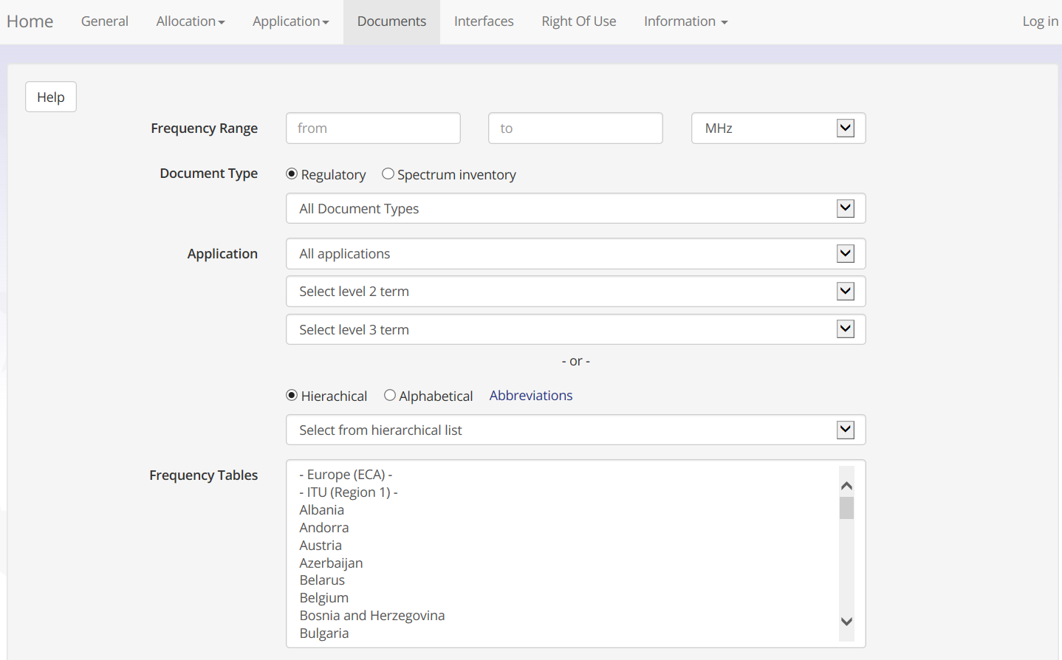

Slide 5
Recent features
Visualisation of allocations and applications (2 options: table search or graphical search)
Questionnaires overview
Electronic Communication Services (ECS) bands – Rights of use (ECO Report 03 information)
ERC/REC 70-03 information for Short Range Devices (SRD)

Slide 6
New EFIS Design

Slide 7
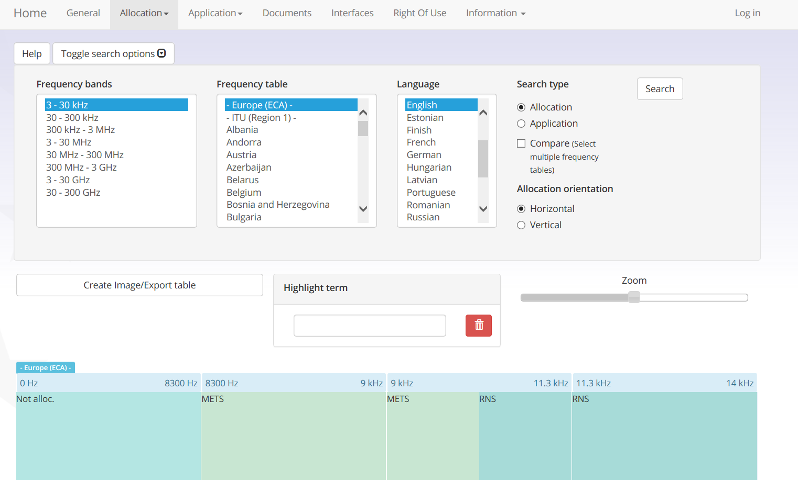
Also a graphical visualisation of allocations and applications

Slide 8
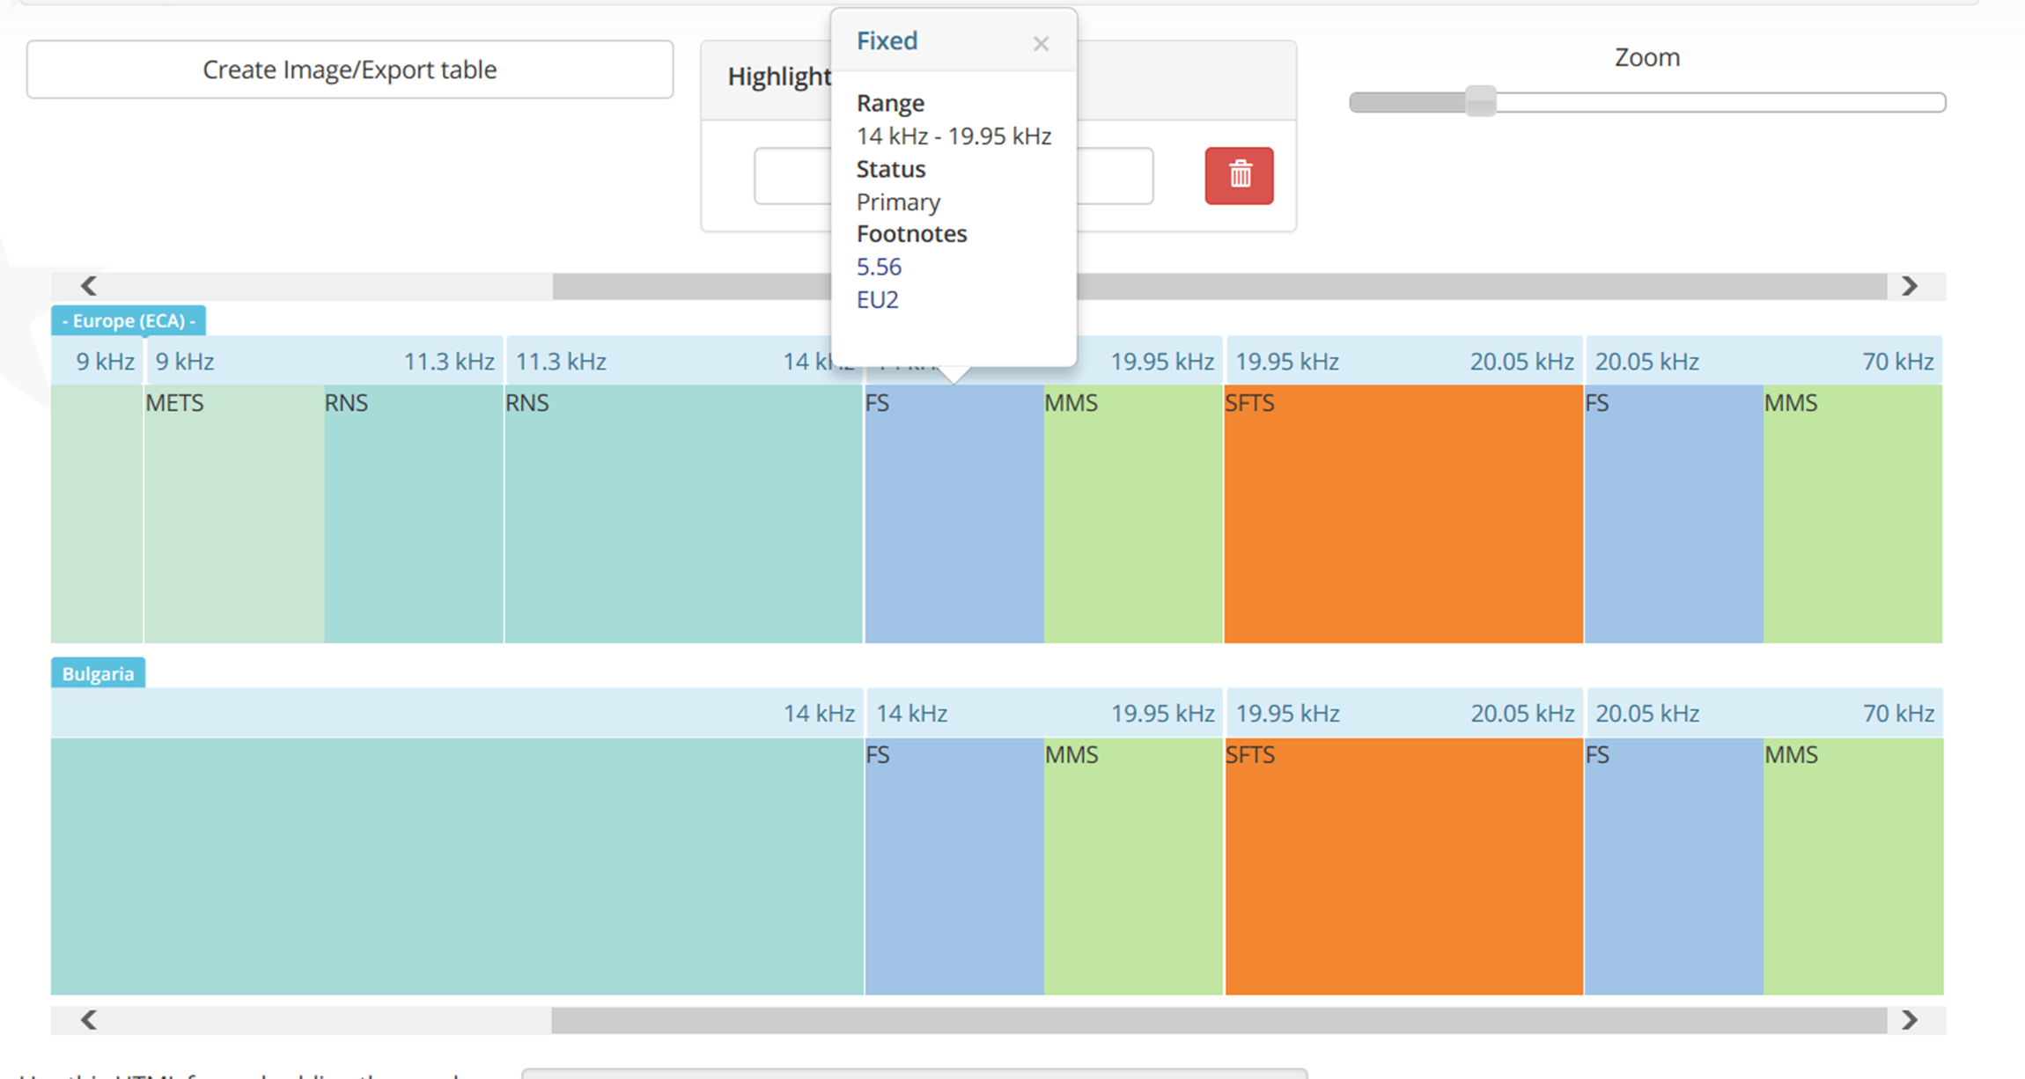
You can compare graphically the allocations or applications
of two or more countries

Slide 9
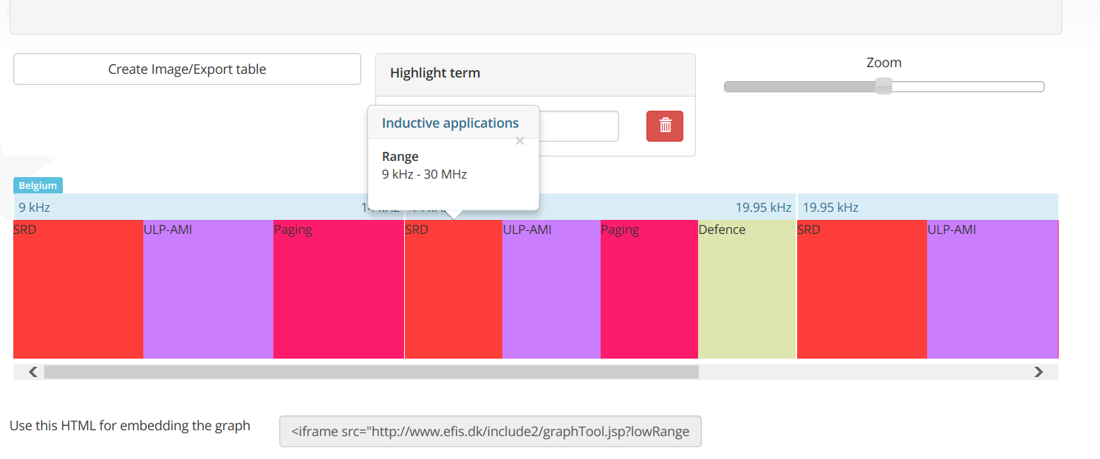
You can zoom, scroll, export picture/ table information, select
horizontal/vertical arrangement of entries, export a link/use the tool
externally

Slide 10
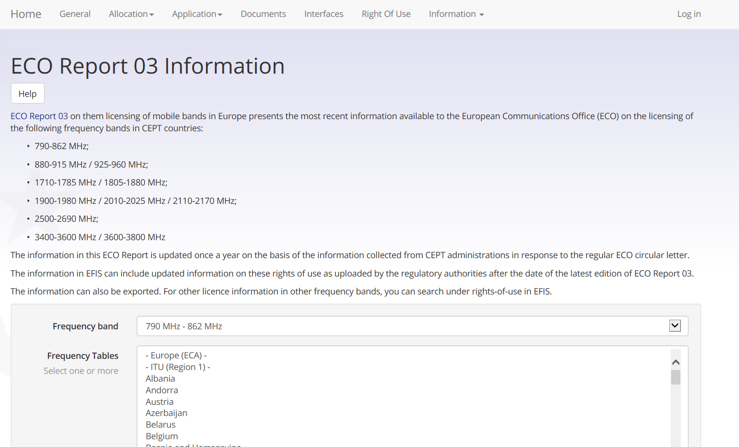
RoU for 44 countries in all ECS frequency ranges

Slide 11
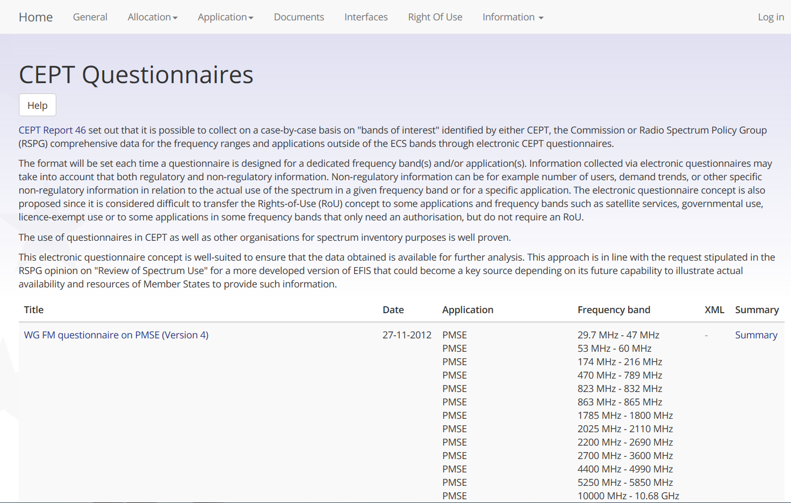
You can get the questionnaire summaries,
also linked to applications and frequency ranges

Slide 13
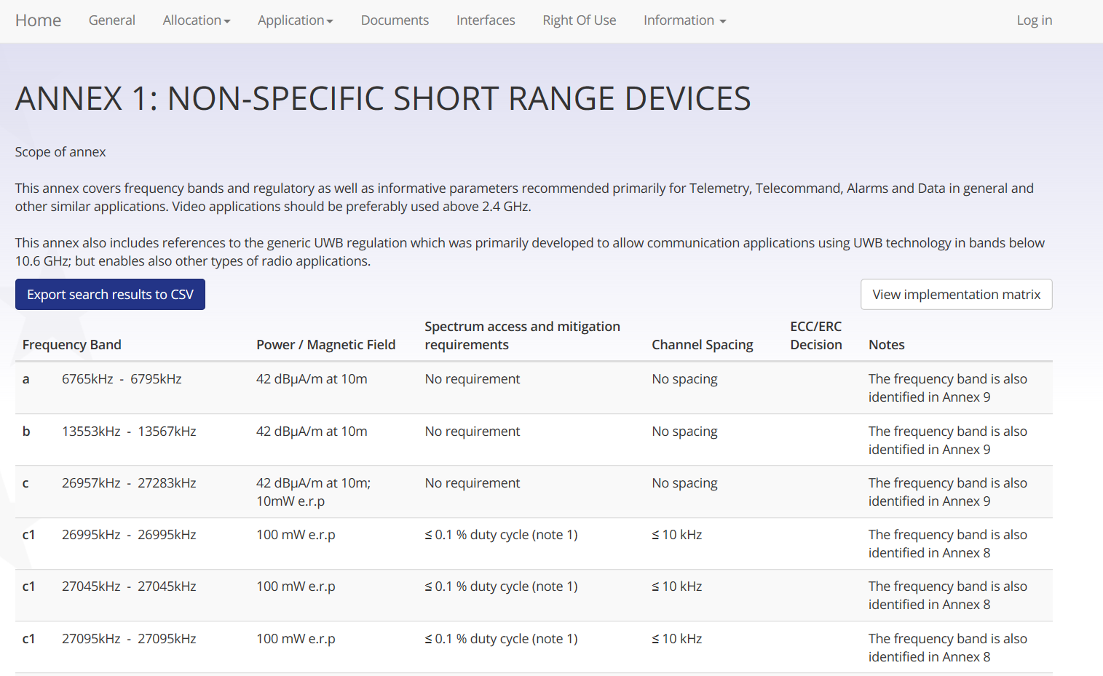

Slide 14
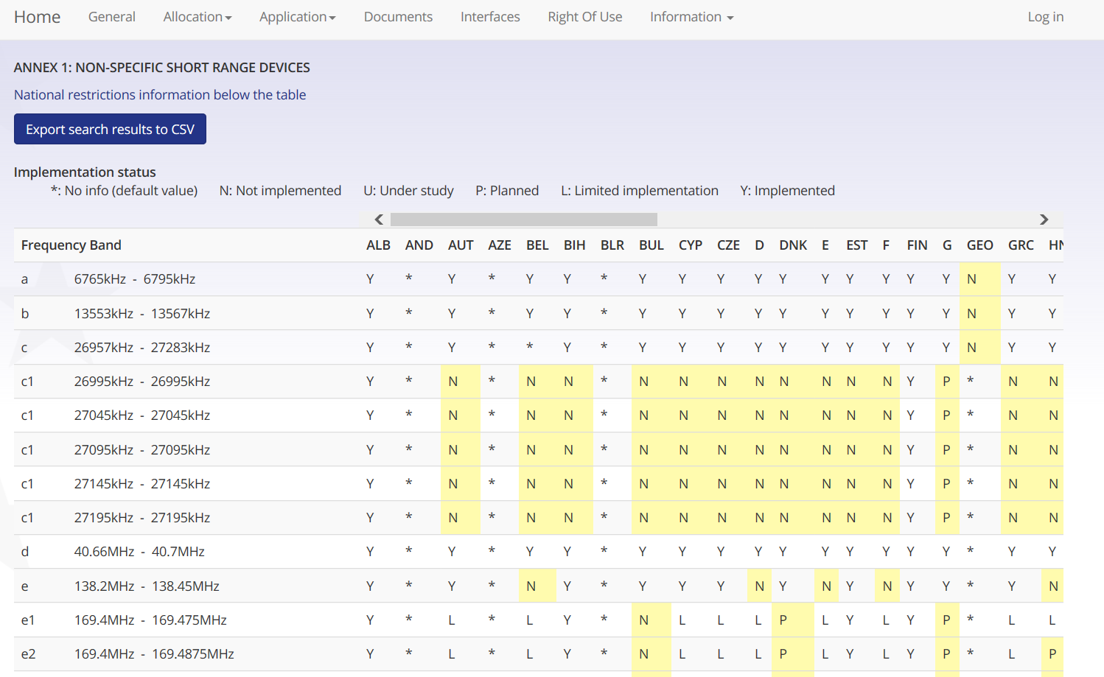
You can find the detailed implementation
information incl. National restrictions

Slide 15
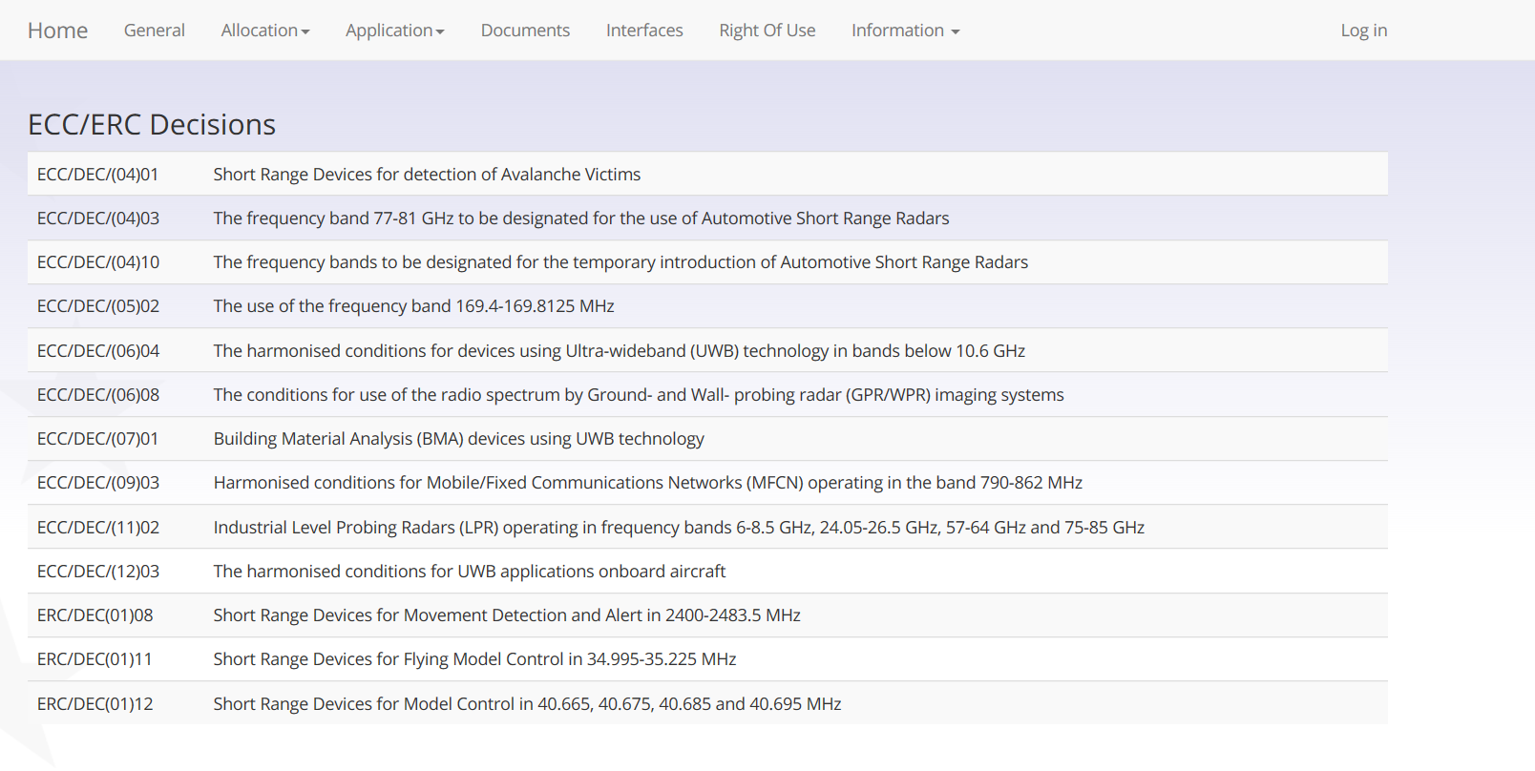
You can get via SRD in EFIS all related information,
here for example the related ECC Decisions)

Slide 16
EFIS contacts in ECO
EFIS contacts in ECO
Bente Pedersen
Bente.pedersen@eco.cept.org
Tel: +45 33 89 63 11
Thomas Weber
Spectrum Management thomas.weber@eco.cept.org
Tel: +45 33 89 63 12
ECO
Nyropsgade 37, 1302 Copenhagen, Denmark Tel: +45 33 89 63 00 Fax: +45 33 89 63 30
eco@eco.cept.org

Slide 17
Sources of information/relevant documents for detailed guidance/information on EFIS
www.efis.dk and EFIS website page and www.ecodocdb.dk (all documents are available here)
ECC Report 180 on guidance on the interpretation of requirements in ECC/DEC/(01)03
ECC/DEC/(01)03 on EFIS (current version February 2013)
List of searchable allocations (Annex 1) is updated as required (after a WRC)
List of searchable applications (Annex 2) is updated as required (EFIS/MG proposes changes to WGFM)

